Slide 1
Boosting vs. Stacking
Intermediate presentation
Applied Machine Learning

Slide 2
Agenda
1
Ensemble learning
2
Boosting
3
Stacking
4
Boosting vs. Stacking
5
XGBoost

Slide 3
Ensemble Learning
Improve prediction by combining multiple classifier
Combine multiple classifier
Goal of ensemble learning
Better predictive performance
Different methods for constructing ensembles
Boosting, Stacking, Bagging, Bucket of models, …
Classifier 1
Classifier ...
Prediction
Classifier 2
Classifier n

Slide 4

Boosting
https://content-static.upwork.com/blog/uploads/sites/3/2015/06/22162235/UP_17-tps-4-boosting-yr-success_M-940x400.jpg

Slide 5
Boosting
Learn from the failures of the previous Classifier
Multiple classifier of the same type
Mostly weak classifiers
Iteratively procedure
Future classifiers focus on misclassified data
Learner weighted according to accuracy
Many boosting algorithms
Adaboost, BrownBoost, xgboost, LogitBoost, …
Decision Tree 1
Decision Tree 2
Decision Tree 3
Decision Tree 1
Weighted Data
Decision Tree 2
…

Slide 6
Adaboost
How adaboost works
h₁
h₂
h₃
h_{final}= sgn
W₁*
+ W₂*
+ W₃*

Slide 7
Boosting in MLR
Different boosting methods are integrated in MLR
Integrated learners in MLR
classif.ada ~ Adaboost
classif.blackboost ~ Gradient Boosting With Regression Trees
classif.bst ~ Gradient Boosting
…
regr.blackboost ~ Gradient Boosting with Regression Trees
regr.bst ~ Gradient Boosting
…
lrn = makeLearner("regr.gbm", n.trees = 100)
mod = train(lrn, bh.task)

Slide 8

Stacking
http://cdn.shopify.com/s/files/1/0740/0911/products/4471_rainbow_stacking_boxes.jpeg?v=1465831016

Slide 9
Stacking / stacked generalization
Predict on predictions
Combine different classifiers
Classifier 1
Prediction 1
Data
Classifier …
Prediction …
Classifier
Final Prediction
Classifier N
Prediction N
Base classifier – Level 0
Meta classifier – Level 1
Diverse base classifiers yield to good performance
Important to choose the right meta classifier

Slide 10
Stacking in MLR
Basic Example of using makeStackedLearner
base = c("classif.rpart", "classif.lda", "classif.svm")
lrns = lapply(base, makeLearner)
m = makeStackedLearner(base.learners = lrns, super.learner = "classif.kknn", method = "stack.cv")
tmp = train(m, iris.task)
res = predict(tmp, iris.task)

Slide 11
Boosting vs. Stacking
Comparing boosting and stacking
Boosting
Ensemble method
Same classifiers
Focus on misclassified data
Sensitive to noise
Formula used to weight data
Easy to set up
Stacking
Ensemble method
Different classifiers
More robust
Model used to weight data
More difficult to set up
(Slower)
(Better prediction performance)

Slide 12

XGBOOST
https://raw.githubusercontent.com/dmlc/dmlc.github.io/master/img/logo-m/xgboost.png

Slide 13
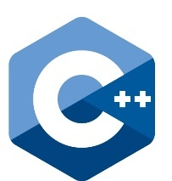





Xgboost
gradient boosting framework
XGBoost is short for eXtreme Gradient Boosting
Scalable and flexible gradient boosting framework
Supports multiple languages
Many Kaggle competitions were won with XGBoost

Slide 14
What makes the difference
Difference between gbm and xgboost
Performance
Regularization
Prune on full binary trees
Speed
Parallel Processing with OpenMp
Customization
Custom optimization objectives
Parameter tuning

Slide 16
Chen, T. and Guestrin, C. (2016), “XGBoost : Reliable Large-scale Tree Boosting System”, arXiv, pp. 1–6.
Dzeroski, S. and Zenko, B. (2002), “Stacking with Multi-response Model Trees”, Multiple Classifier Systems. Lecture Notes in Computer Science, Vol. 2364, pp. 201–211.
Hatami, N. and Ebrahimpour, R. (2007), “Combining Multiple Classifiers: Diversify with Boosting and Combining by Stacking”, IJCSNS International Journal of Computer Science and Network Security, Vol. 7 No. 1, pp. 127–131.
Pan, Q., Darabos, C. and Moore, J. (2012), “Advances in Intelligent Data Analysis”, 4th International Conference, IDA 2001, Cascais, Portugal, September 2001 Proceedings, Vol. 7246 No. January 2001, pp. 122–133.
Schapire, R.E. (1999), “A brief introduction to boosting”, IJCAI International Joint Conference on Artificial Intelligence, Vol. 2 No. 5, pp. 1401–1406.
Shunmugapriya, P. and Kanmani, S. (2013), “Optimization of stacking ensemble configurations through Artificial Bee Colony algorithm”, Swarm and Evolutionary Computation, Vol. 12, pp. 24–32.
Syarif, I., Zaluska, E., Prugel-Bennett, A. and Wills, G. (2012), “Application of bagging, boosting and stacking to intrusion detection”, Lecture Notes in Computer Science ( Including Subseries Lecture Notes in Artificial Intelligence and Lecture Notes in Bioinformatics), Vol. 7376 LNAI, pp. 593–602.
Ting, K.M. and Witten, I.H. (1999), “Issues in stacked generalization”, Journal of Artificial Intelligence Research, Vol. 10, pp. 271–289.
Wang, G., Hao, J., Ma, J. and Jiang, H. (2011), “A comparative assessment of ensemble learning for credit scoring”, Expert Systems with Applications, Vol. 38 No. 1, pp. 223–230.
“XGBoost”. (n.d.). , available at: https://xgboost.readthedocs.io/en/latest/ (accessed 23 October 2016).

Slide 17
Different approaches
SCANN, Grading and Stacking with multi-response trees
SCANN
Core idea: Correspondence analysis to remove dependencies
Meta Level: Nearest neighbor method
Grading
Core idea: Meta-level classifier for each base classifier
Meta Level: Predicts whether the base classifier is to be trusted
Stacking with Multi-Response Model Trees
Core idea: Base classifiers whose predictions are probability distributions
Meta Level: Model Trees
Notes:
SCANN that uses correspondence analysis do detect correlations between the predictions of base-level classifiers. The original meta-level feature space (the class-value predictions) is transformed to remove the dependencies, and a nearest neighbor method is used as the meta-level classifier on this new feature space.
use base-level classifiers whose predictions are probability distributions over the set of class values, rather than single class values. The meta-level attributes are thus the probabilities of each of the class values returned by each of the base-level classifiers. The authors argue that this allows to use not only the predictions, but also the confidence of the base-level classifiers. Multi-response linear regression (MLR) is recommended for meta-level learning, while several learning algorithms are shown not to be suitable for this task.
propose a method for combining classifiers called grading that learns a meta-level classifier for each base-level classifier. The meta-level classifier predicts whether the base-level classifier is to be trusted (i.e., whether its prediction will be correct). The base-level attributes are used also as meta-level attributes, while the meta-level class values are + (correct) and − (incorrect). Only the baselevel classifiers that are predicted to be correct are taken and their predictions combined by summing up the probability distributions predicted.

Slide 18
Stacking in MLR
Explanation
makeStackedLearner(base.learners, super.learner = NULL, method = "stack.nocv", use.feat = FALSE)
Method parameters
average: averaging the predictions
stack.cv: using crossvalidated predictions for super learner
stack.nocv: using not crossvalidated predictions
hill.climb: averaging the predictions weights learned from hill climbing algorithm
compress: mimic the predictions of base learners
Notes:
In computer science, hill climbing is a mathematical optimization technique which belongs to the family of local search. It is an iterative algorithm that starts with an arbitrary solution to a problem, then attempts to find a better solution by incrementally changing a single element of the solution. If the change produces a better solution, an incremental change is made to the new solution, repeating until no further improvements can be found.

Slide 19

Objective function
Too many splits, Omega(f) is high
Wrong split, L(f) is high
Good balance of Omega(f) and L(f)

Slide 20
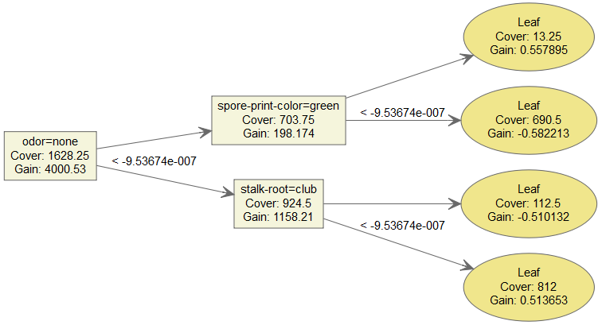
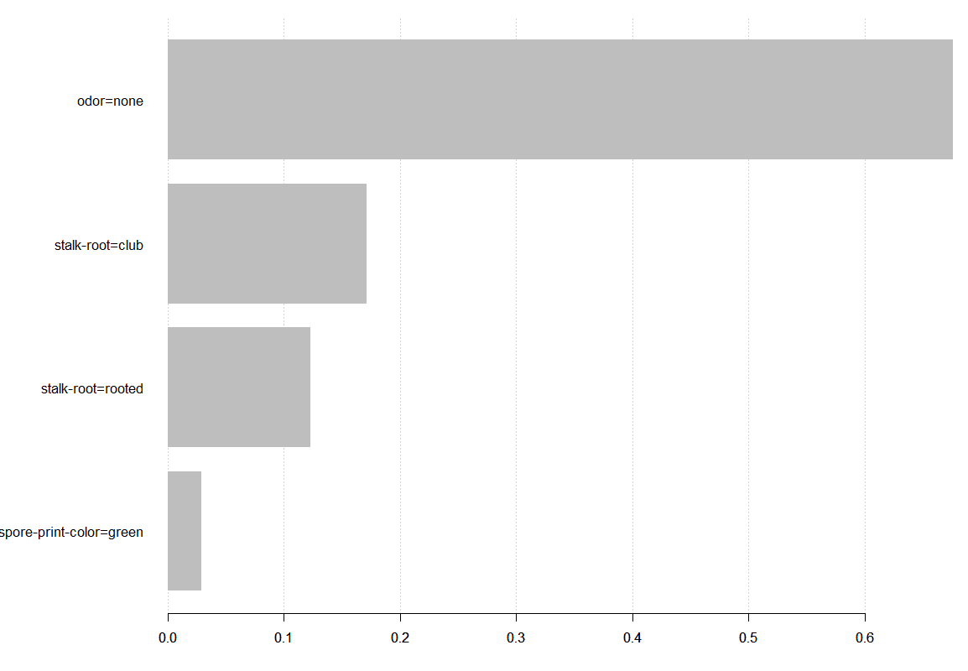
Some Features of xgboost
xgboost
Tree Graphs
Feature importance plot
Save models
Paramter tuning
…

Slide 21
How to use
xgboost
bst <- xgboost(data = train$data,
label = train$label, max.depth = 2, nround = 2, nthread = 2, objective = "binary:logistic")
→ Input data must be numeric

Slide 22
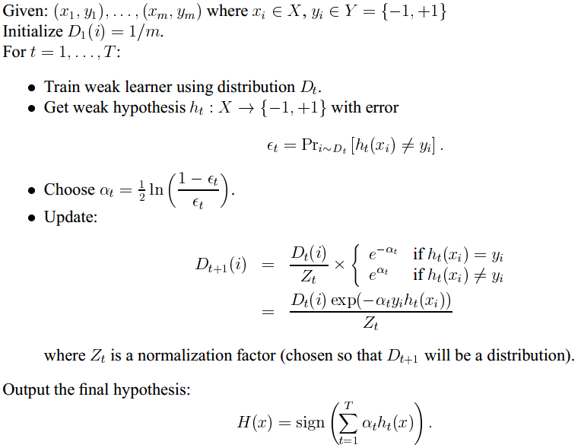

Slide 23
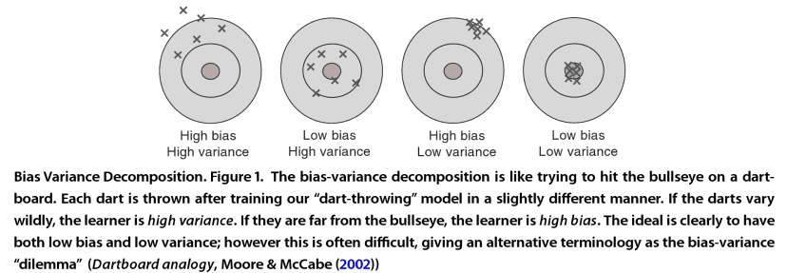
http://stats.stackexchange.com/questions/17537/understanding-variance-intuitively

Slide 24
